Slide 1
EDA Of Educational Loan Application Data

Slide 2
Problem Statement
A FinTech company specialize in lending loans to customers. They are interested in lending money to one lakh student as an educational loan without considering credit history. Moreover, they also want to understand the patterns in these one lakh clients’ difficulty in paying installments. These features can help in identifying such loans applications and can lead to denying the loan, reducing the amount of loan, lending (at a higher interest rate) and, thereby improving there portfolio and risk assessment .

Slide 3
Abstract
This report provides an Exploratory Data Analysis (EDA) of loan repayment data to uncover insights into borrower behavior, particularly regarding the likelihood of delayed EMI payments. The dataset includes attributes such as loan repayment status (dpd_days), annual income, interest rate, lender information, and borrower details including current state, city, and pincode. The analysis involved data cleaning, outlier removal, and handling missing values. Key findings reveal significant patterns, including high percentages of delayed payments in specific states and pincodes, profession and annual incomes’ effect on loan repayment behavior and a trend where the likelihood of delayed payments drops below 50% at certain income levels. Lender-specific insights highlight the probability of delays among its borrowers. This comprehensive analysis provides valuable insights for risk assessment and offers actionable recommendations to enhance lending strategies and borrower management.

Slide 4
Data Description
Key Columns: dpd_days, profession, annual_income, current_state, current_city, lender_name, interest rate, tenure
Size of data: 101710 rows and 33 columns

Slide 5
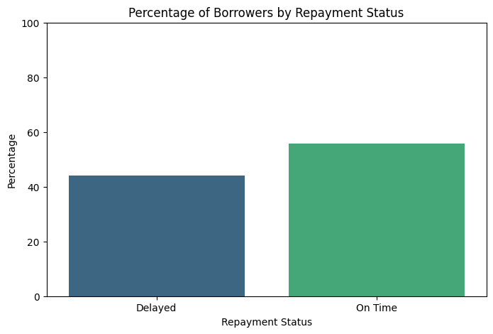
Borrower to Loan Repayment Status
Cleaned the dpd_days data, removed outliers using IQR method .
Calculate the number of unique borrower who have Delayed and On Time during repayment.
Got a result where 44.20% borrowers Delayed and 55.80% borrowers On Time payment was completed.

Slide 6
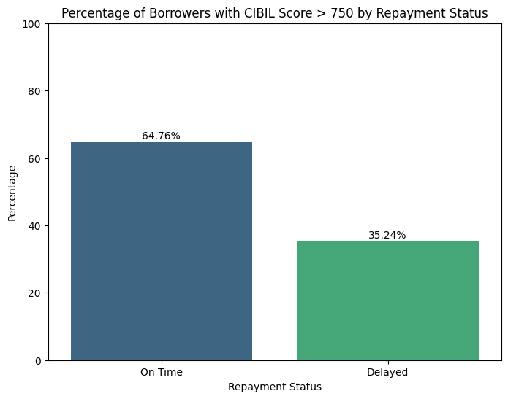
Borrowers with Cibil Score Repayment Status
Removed outliers from dpd_days
Remove the string error with converting them to NaN values and replace them with median value of the whole ‘Cibil score’ column.
The borrower who delayed in paying with cibil score higher than 750 was 35.24%
Most of the borrowers(64.76%) with cibil score higher than 750 are safe borrower according to this analysis.

Slide 7
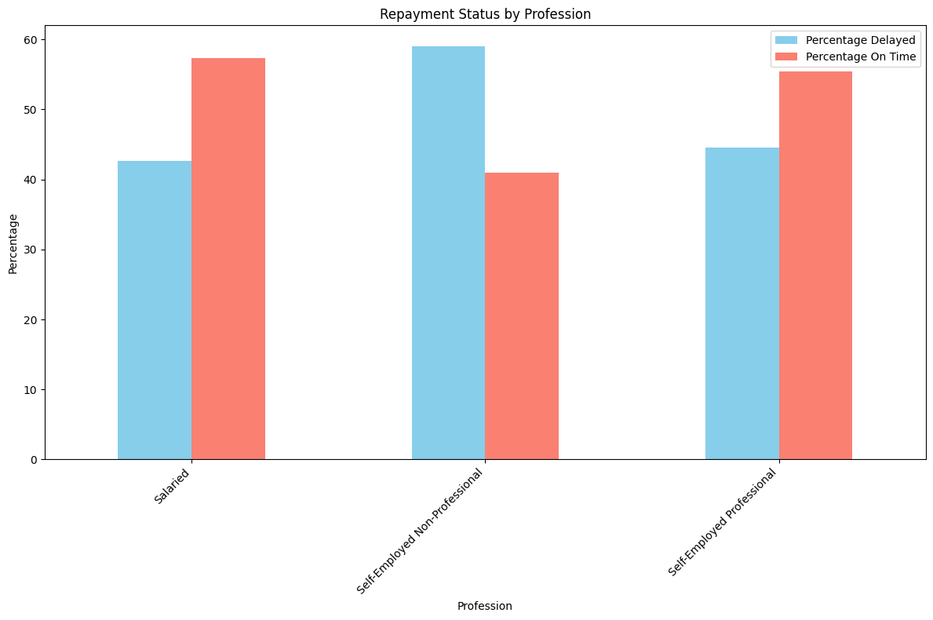
Profession to Repayment Status
We have got the result as-
Profession: Salaried-
Percentage Delayed: 42.67%
Percentage On Time: 57.33%
Self Employeed Non Professional-
Percentage Delayed: 52.06%
Percentage On Time: 40.94%
Self Employeed Professional-
Percentage Delayed: 44.51%
Percentage On Time: 55.49%
Self Employeed Non Professionals are riskier to lend money.

Slide 8
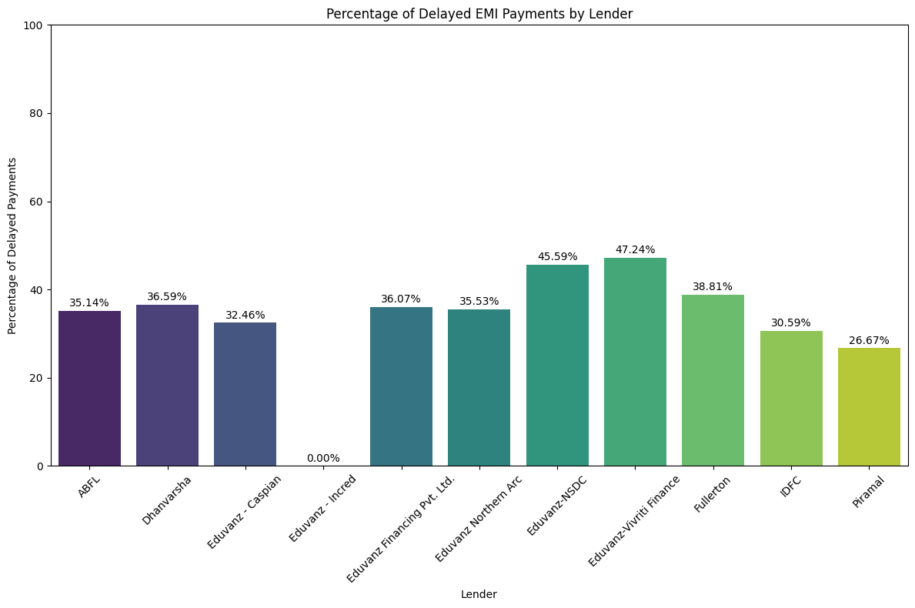
Lender Repayment Status
Eduvanz-Vivriti Finance has faced the higest delay payment percentage of 47.24%
Eduvanz-Incred has no Delay percentage.
Piramal, IDFC have seen quite low Delay percentage( simultaneously 26.67% and 30.59%).

Slide 9
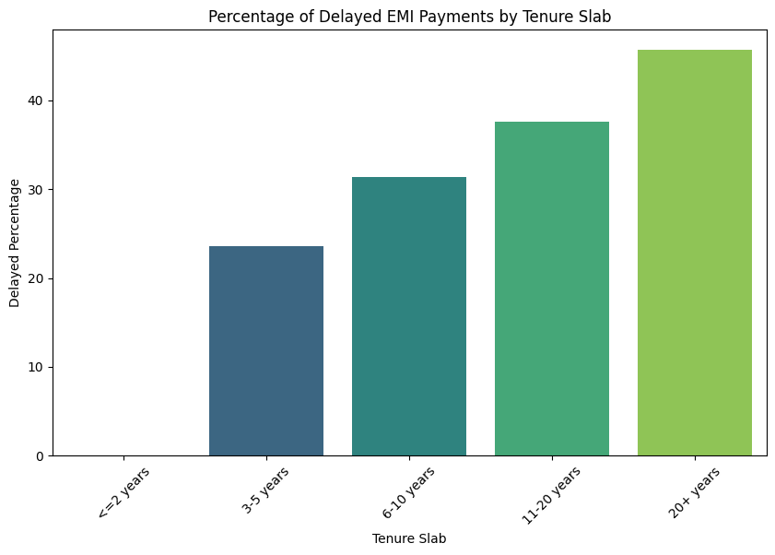
Tenure of Borrowers with Repayment Status
The borrowers with 20+ years of tenure are more likely to be delayed and riskier than others.
As the tenure increases the risk of delay increases.
The borrowers with less than 2 years of tenure have no risk of delaying.

Slide 10
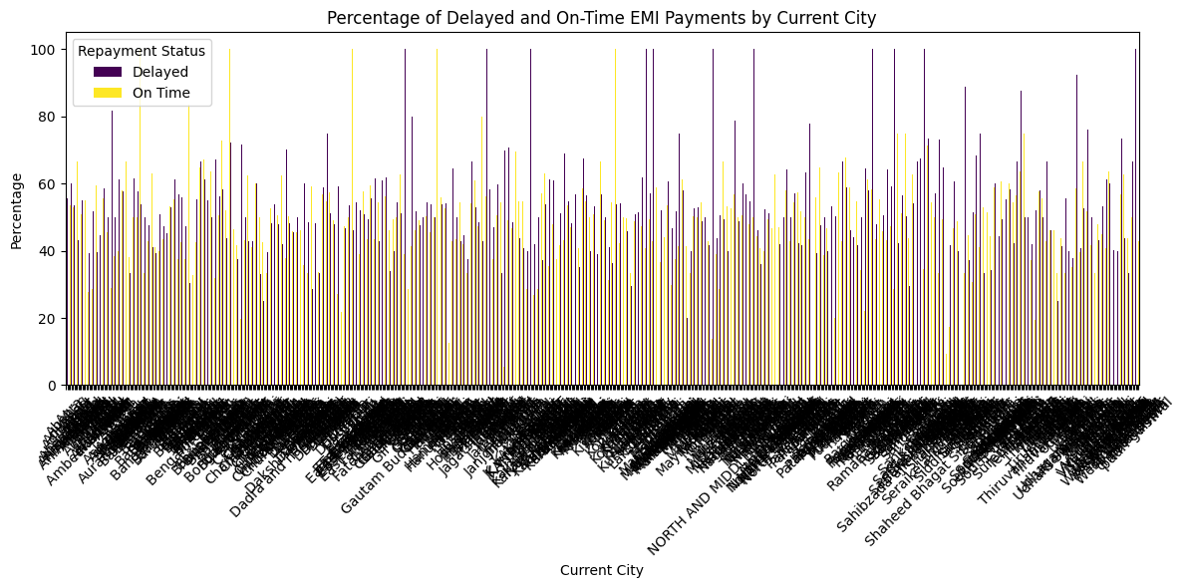
Tier1 city borrower Repayment status
Average Percentage of delayed EMI payments is: 52.05%.
Maximum percentage of delayed EMI payments is: 100.00%
Number of delayed percentage which are close to 100 is little bit higher and On time is lower in comparison.

Slide 11
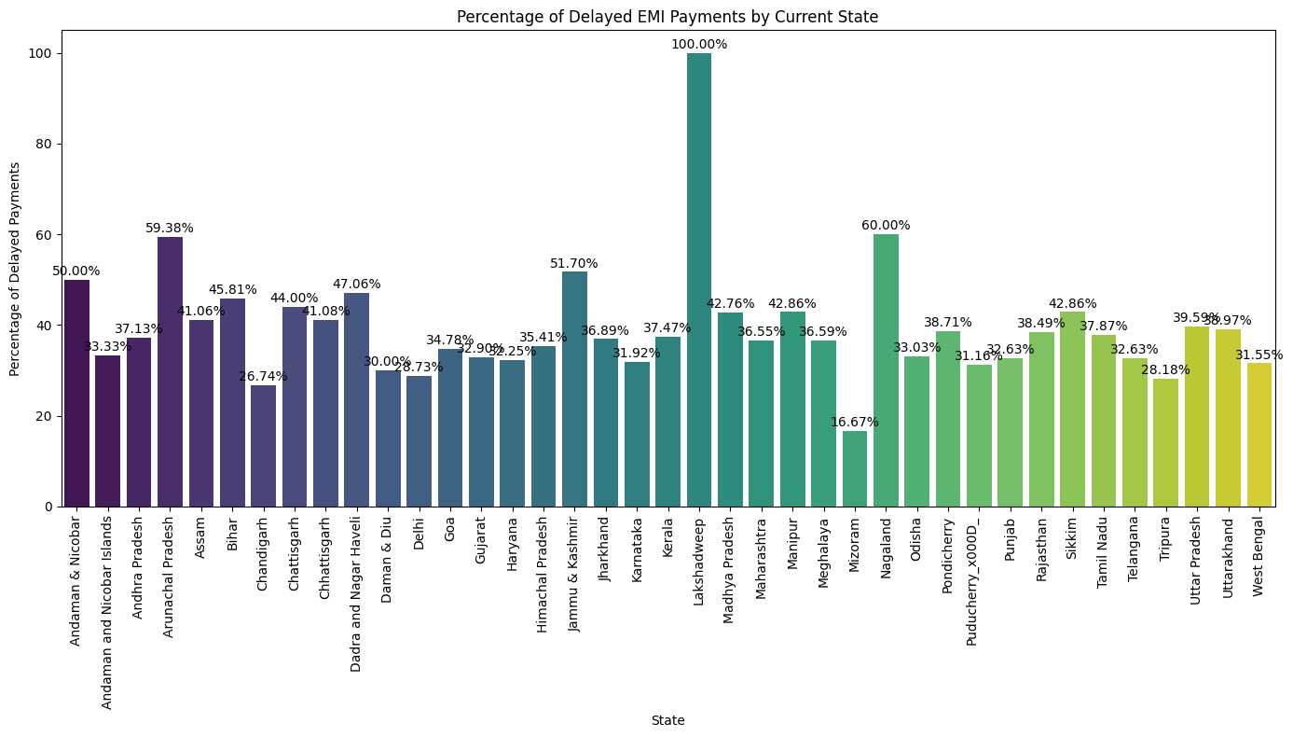
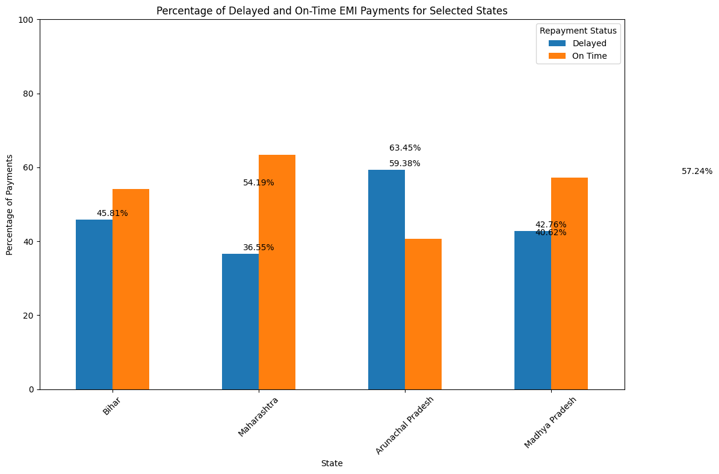
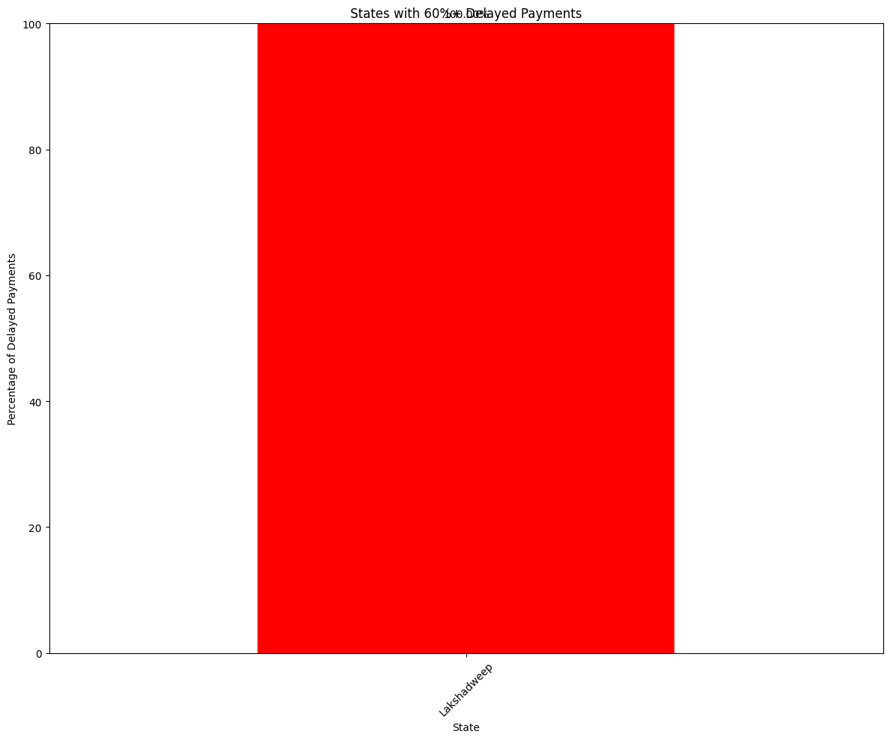
State wise borrower Repayment Status
Lakshadweep has highest delay percentage of 100%, after that Nagaland with 60% delay percentage, Arunachal pradesh with 59.38% delay have been recorded.
Other states have less than 50% delay in repayment behavior.

Slide 12
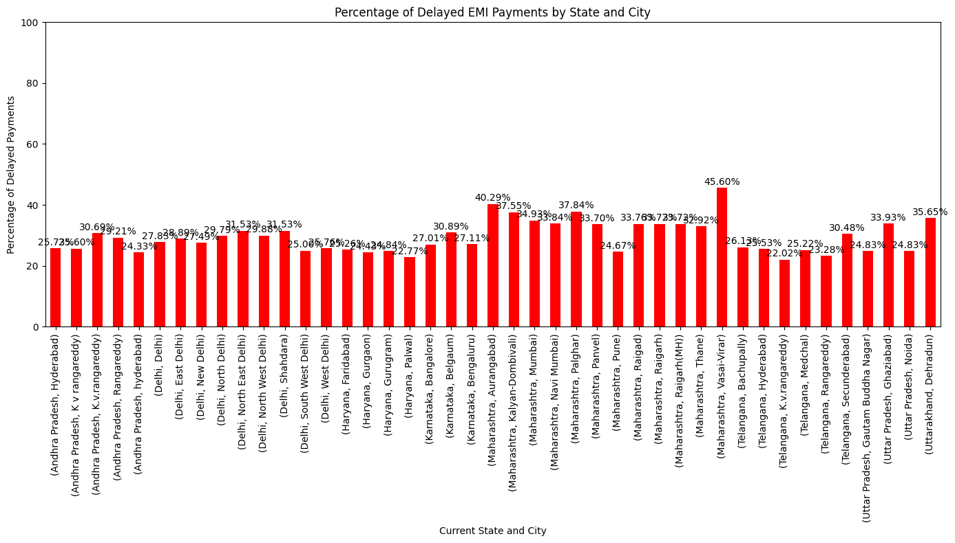
Pincode and their mapped city and state relationship with EMI payment
Maharashtra, Vasai-Virar with highest delayed percentage of 45.60% can be considered as most risky location to give money to borrow where at least 100 borrowers has been taken into account to make this analysis.
Another location of Maharashtra, Aurangabad has recorded as 40.29% delay and can be considered as high risk location for lending money.

Slide 13
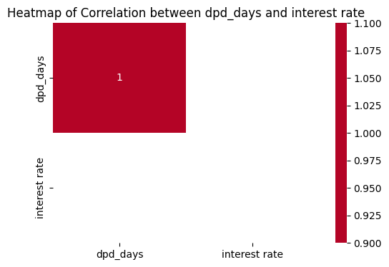
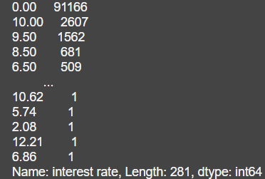
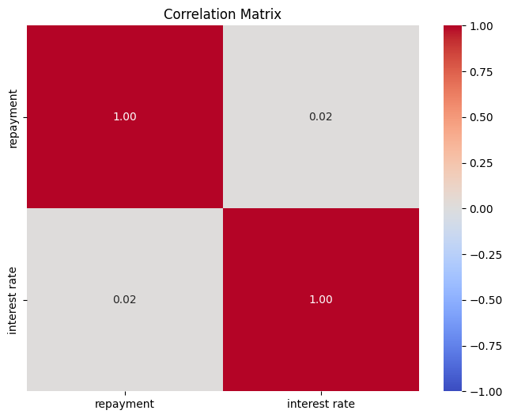
EMI payment and Interest rate
Removed outliers from dpd_days , but kept the outliers of interest rate where borrowers with 0.00 are 91,166, almost 91% data belongs to this group. Then got 0.02 as correlation value of EMI payment and Interest rate.
When outliers of interest rate is removed no correlation is found between them.

Slide 14
Eduvanz lender delay risk
Percentage of Delayed and On Time payment are:
On Time:- 63.81%
Delayed:- 36.19%

